Slide 1

March 10 - 12, 2015
Cobb Galleria Centre
Consulting vs. Industry
Charting a Professional Technical Career Path
Presented by
Monika Mueller
Managing Director, Atlanta Office
Ron Stacey
Program Manager, Atlanta Office

Slide 2


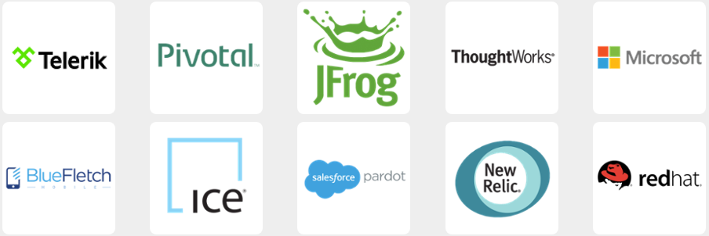
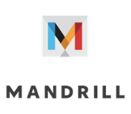




Thanks to Our Sponsors
March 10 - 12, 2015

Slide 3
introductions
Monika Mueller
Monika Mueller is the Managing Director for Daugherty Business Solutions in Atlanta, Georgia. She’s had a long career in IT and business consulting, delivering solutions to large organizations in a variety of industries and process areas.
Prior to joining Daugherty Business Solutions, Mueller held positions at General Motors, PricewaterhouseCoopers and Ernst & Young. At one of these predecessors, Mueller was managing 60+ on and off shore development resources to implement a $13 million program.
With a strong record of success, she’s leading a talented team of individuals to be innovative in solving business problems and achieving business value through the solution.
Ron Stacey
Ron Stacey is a Program Manager for Daugherty Business Solutions in Atlanta, Georgia. His 27 years in IT and business have spanned systems integration, network engineering, development, database administration, and project management for large application development & implementation projects. Ron has managed or participated in technical solutions projects on four continents. During his career, he’s spent roughly equal time in consulting and industry, in the energy management, healthcare, telecommunications, banking/finance, transport/shipping, industrial manufacturing, retail, and public sectors
March 10 - 12, 2015

Slide 4
three areas we’ll cover…
potential paths
for technical career growth
pros and cons of each
assessing
which is best for you
March 10 - 12, 2015

Slide 5

two paths to your goals as a technical professional
Industry
Commercial
Government
Non-profit
Consulting
Multinationals
Niche
Local models
so which way is right for you?
March 10 - 12, 2015

Slide 6

charting a direction
guideposts
what is each and their pros and cons?
when in your career does each fit you best?
who are you – traits, preferences, goals?
where are the possible tracks?
how do you go about it?
it depends!
March 10 - 12, 2015

Slide 7
what…
Consulting
[kuh n-suhl-teeng]
Not the same as contracting
Ever changing roles and hierarchies
Consultants:
Roles can be unclear and changing
Have multiple “bosses”
Responsibly to the Client and their Consultancy
Are solution crafters, not order takers
Industry
[in-duh-stree]
Defined role within an established hierarchy
Employees:
Role clearly delineated
Could have direct supervisory relationships
Responsibility for specific areas
March 10 - 12, 2015

Slide 8
what…
industry pros
Perceived stability, ownership
Connection within sector, industry
Depth of company-specific knowledge
Predictable hours, work-life balance
No travel – 90% of time in office
Learning interpersonal skills, understanding for organizational politics, superior-subordinate management
industry cons
Risk of stagnation and boredom
Limited promotion opportunities
Organization politics, hierarchy, siloing
More challenging to network
Lower income potential
March 10 - 12, 2015

Slide 9
what…
consulting pros
Rapid skill development, lots of training
Multi-industry exposure
Variety and change
Continuous opportunity for learning & development
Relationship-building, collaboration
Exposure to Sr. people, networking
Honing professional and problem-solving skills
Influencing and conflict management skills because there’s a looser hierarchy
Broader roles that lead to quicker progression
Working with top talent
Travel
Higher earning potential
consulting cons
Heavy travel in many positions
Often longer hours than industry
Constant change, stretch demands
Risk of developing broad as opposed to deep knowledge
Difficulty in keeping a social network
Pace, pressure
Limited opportunity to learn organizational / hierarchical skills
March 10 - 12, 2015

Slide 10
when vs. what
consulting
pros
Flexibility, variety
Building competency w/ tools
Satisfaction – applying extensive experience to solving big problems
Ability to speak your mind
Rapid skill growth
Honing professional habits, skills
Variety & change
Exposure to sr. mgmt, networking
Developing competency w/ tools
Salary
late career
Coaching opportunities
mid career
Travel in most roles
Constant change, stretch demands
Pace, pressure
Limited opportunity for executive roles
Sales expectation
Improved problem-
solving skills
Heavy travel in most roles
Work / life balance
Constant change, stretch demands
Pace, pressure
Sales expectations
Salary
Work-life balance
Social connections
Constant change, stretch demands
Pace, pressure
early career
cons
March 10 - 12, 2015

Slide 11
when vs. what
industry
pros
Access to senior, executive roles
Building network and reputation
within company, industry
Hierarchical power, authority
Honing organizational skills
Work-life balance
Building organizational skills
late career
Intra-industry connections
Knowledge depth
mid career
Narrow focus
Boredom, stagnation
Organizational politics
Career / retirement risk
Hours, work-life balance
Limited networking, variety
Earnings
Organizational politics
Long, involved advancement
Earnings
Limited influence & access
No travel, limited variety
Limited skill development
early career
cons
March 10 - 12, 2015

Slide 12
who… traits
consulting
adaptive, flexible, enjoy change
problem solvers, innovators, strategists
big picture ‘systems’ thinking
constantly learning
relationship builders
effective communicators
ability to digest and/or lots of information in a short time and concise format
self-motivated, need little direction
transparent & accountable
relish the advisor role
unafraid to speak directly
industry
value stability
prefer clearly delineated areas of responsibility
prefer defined relationships
sensitive to organizational politics
focus on a particular function, product or service
sense of belonging, organizational integration
sense of ownership
March 10 - 12, 2015

Slide 13
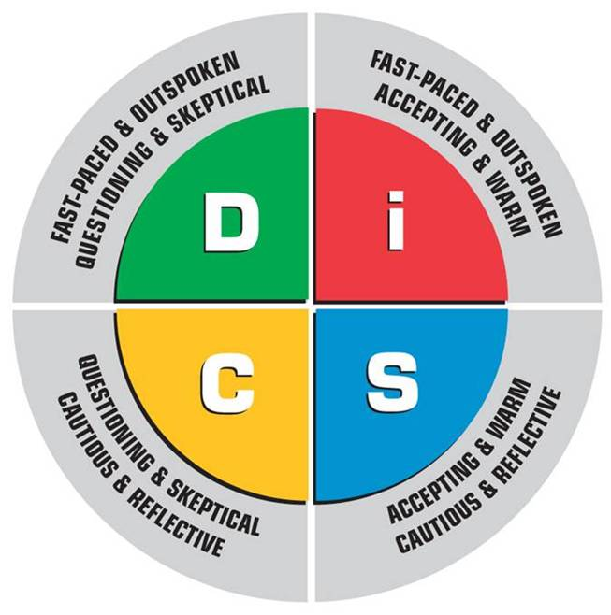
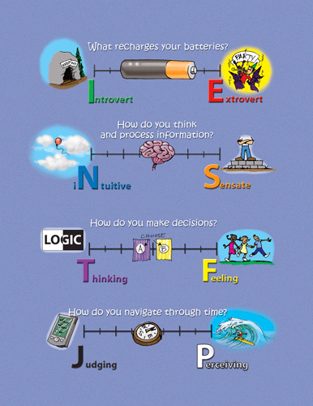

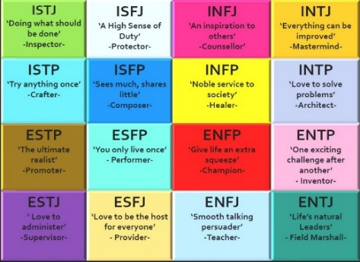
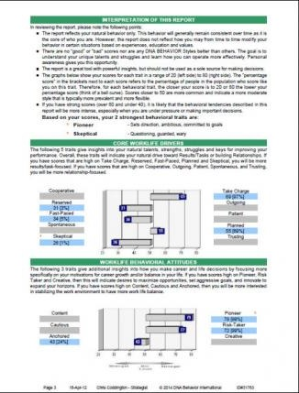

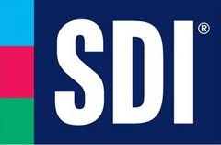
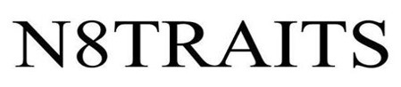
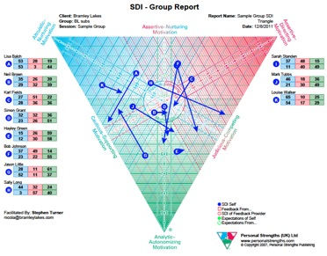
who… assessing fit
March 10 - 12, 2015

Slide 14
who… assessing
N8Traits
measures a range distribution for 10 work-life drivers and 6 planning drivers
accurate for 90% of the population
remains stable over time, expands analysis beyond profiles alone
yields 10 work-life profiles and describes interaction styles between them:
Adapter | Community Builder | Engager | Facilitator | Influencer
Initiator | Reflective Thinker | Relationship Builder | Strategist | Stylish Thinker
Also provides driver strength graph, strongest traits analysis, comparison to averages, compatibility analysis, strengths / weaknesses analysis
March 10 - 12, 2015

Slide 15
who – assessing
N8Traits style groups
N8Traits assessments result in a style grouping based on the strength of identification with each of the 10 work-life drivers and 6 behavioral attitudes; these are only part of a full assessment result, but provide a useful shorthand for preferences and likelihood of positive interaction.
Style Group | Headline
Adapter | Uniquely adaptive, versatile; prefer clear expectations
Community builder | Excel at ‘people skills’; supportive, focus on group goals
Engager | Extroverted, enthusiastic; more starters more than finishers
Facilitator | Agenda setters, guiders; require stability; good w/ group decisions
Influencer | Like to be at center of decision making; strong motivators
Style Group | Headline
Initiator | Like to take bold, aggressive action and create the rules
Reflective Thinker | Serious, focused, analytical, objective; problem-solvers
Relationship Builder | Comfortable working with and serving others; prize stability
Strategist | Driven to reach goals, focused on knowledge, process & quality
Stylish Thinker | Like interaction, testing ideas via discussion; information-focused
types by industry, consulting or neutral
March 10 - 12, 2015

Slide 16





where…
Financial
Industry options
Direct Technology Firms
Other Technology
Health
Banking / credit services
Securities / investments
Insurance
Public Sector / Education
Software firms, integrators
Computer Systems Design / related
Computer / Electronic manufacturing
Industrial Manufacturing
Telecommunications
Scientific Research / Development
Aerospace
Automotive / transport technology
Utilities / Energy management
Healthcare
Pharmaceuticals
Medical Insurers
HIMS / Analytics
Non-Profit
Federal government
State / Local government
Universities
Educational services
School systems
chemical, machinery, food, steel, etc
March 10 - 12, 2015

Slide 17









where…
consulting options
large multinationals, a.k.a. ‘Big Six’
consulting arms of product or service companies
boutique or niche operations
Local-based models
March 10 - 12, 2015

Slide 18
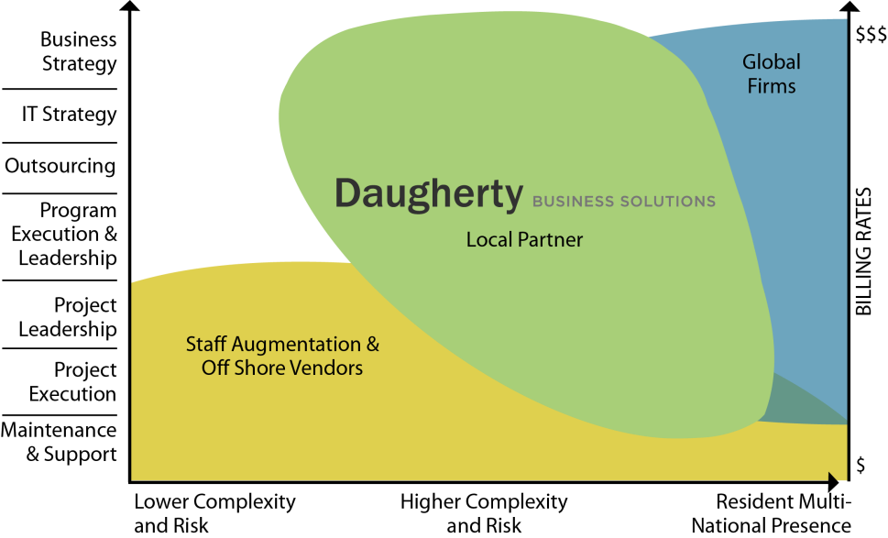
where…
more about the consulting options
Big Six
complexity, access, resources
travel, pigeon-holing, up-or-out, visibility
Consulting arms
resources, recognition, industry advancement
narrow specialization, depth of opportunity, travel
Boutique / Niche
visibility, entrepreneurial, client base
resources, risk, narrow specialization, travel
Local-based
no travel, work-life balance, local visibility, broad opportunities / skill growth
complexity / role type, resources, national visibility
March 10 - 12, 2015

Slide 19
how…
consulting
Find out more at www.Daugherty.com
Contact our talent team at Jen.Moulton@Daugherty.com
Questions? Contact Monika at Monika.Mueller@Daugherty.com
Contact Ron at Ronald.Stacey@Daugherty.com
March 10 - 12, 2015

Slide 20
resources
MBTI: http://www.myersbriggs.org/my-mbti-personality-type/mbti-basics/
SDI: http://www.strengthdeployment.com/sdi/about-sdi-an-overview/
N8Traits: http://www.leeellis.us/leadership-behavior-dna-assessment
Daugherty: http://www.Daugherty.com
Career Options: http://www.forbes.com/sites/dailymuse/2012/11/02/is-consulting-right-for-you/
http://www.strategyexpert.com/articles/leaveconsulting
http://www.jeremyfilliben.com/2009/08/corporate-versus-consulting-jobs.html
http://cranfieldexperience.blogspot.com/2007/10/consulting-vs-industry-is-it-valid.html
http://www.quicksprout.com/2013/07/11/why-consulting-is-a-career-everyone-needs-to-experience/
Professional & http://www.patca.org/
Technical
Consultants
Association:
March 10 - 12, 2015

Slide 21
thank you!
Monika Mueller
Managing Director, Atlanta unit
Ron Stacey
Program Manager
March 10 - 12, 2015

